Slide 1
Root Growth FX
using Unreal Engine 4 for game fx artist

Slide 2
Who am I?

Slide 3

Who am I?
Twitter: https://twitter.com/moko_03_25
Pinterest: https://www.pinterest.jp/moko_vfx/boards/
I’m a Japanese fx artist who has developed several video games:
PS2, PSP, 3DS, PS3, PS4, XboxOne and so on.
And I’m studying English.

Slide 4
Who am I?
I’m sorry if there are mistakes.

Slide 5
Root Growth FX

Slide 6
Root Growth FX
Do you know this tweet already?

Slide 7

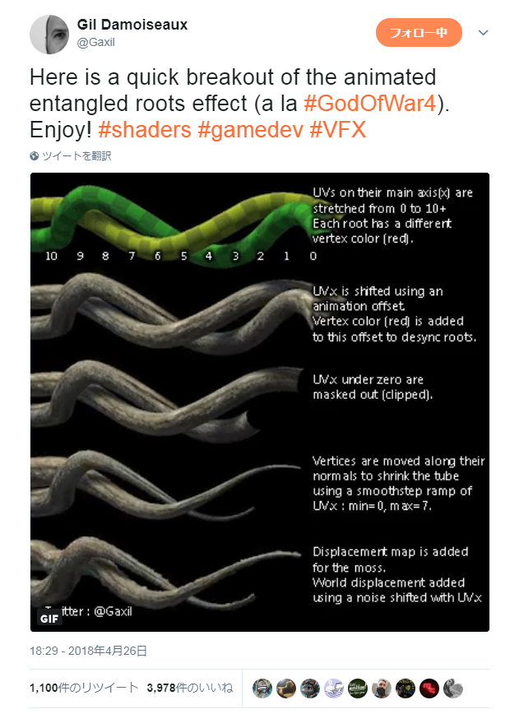
Root Growth FX
Gil Damoiseaux @Gaxil | twitter
https://twitter.com/Gaxil/status/989451306569027586

Slide 8
Root Growth FX
Wonderful work!
I tried the technique as soon as I saw it.

Slide 9
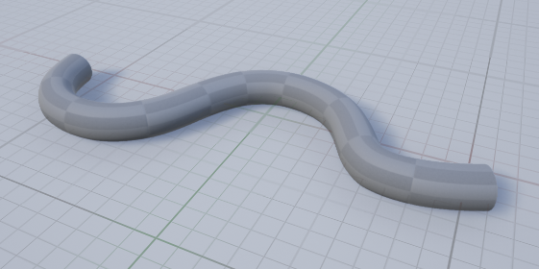
Root Growth FX
First, you need to prepare a pipe-shaped model
and divide polygons into a certain number of pieces.

Slide 10
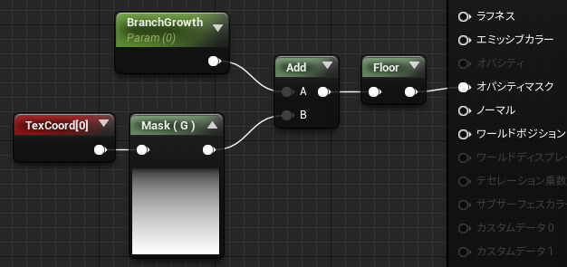
Root Growth FX
Opacity Mask
Next, you need to create a material that like this on UE4.
The blend mode is “Masked”.

Slide 11
Root Growth FX
Opacity Mask
Next, you need to create a material that like this on UE4.
The blend mode is “Masked”.

Slide 12
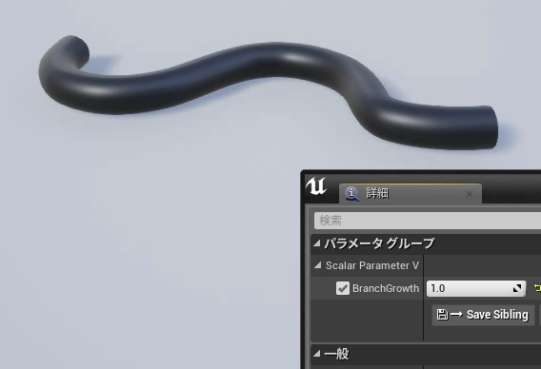
Root Growth FX
If you change the “BranchGrowth”, the root appears. (please press the play button below)

Slide 13
Root Growth FX
Opacity Mask
You can make a gradient from a Texture Coordinate node.

Slide 14

Root Growth FX
Opacity Mask
I forgot to prepare a UV image of this model...
but this is how the UV is opened.

Slide 15
Root Growth FX
Opacity Mask
Then you can create a parameter “BranchGrowth”.
(I want to change the name from “Branch” to “Root”...)

Slide 16
Root Growth FX
Opacity Mask
The gradient and parameters are added and then truncated.
What does that mean?

Slide 17
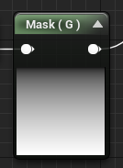
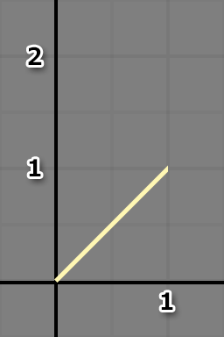
Root Growth FX
It may be unnecessary, but I’ll explain it carefully.
First, this is a graph of a linear gradient.

Slide 18
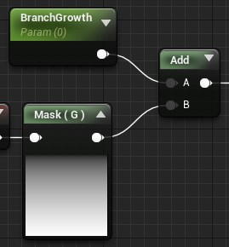
Root Growth FX
0
If the “BranchGrowth” is 0, the graph is unchanged.

Slide 19

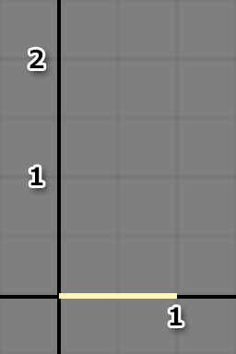

Root Growth FX
And when the value is truncated, it all goes to 0.

Slide 20
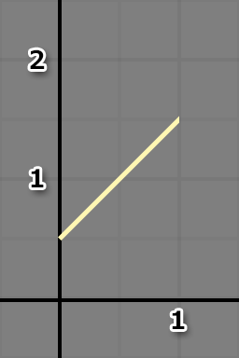
Root Growth FX
0.5
If the “BranchGrowth” is 0.5, the entire graph increase by 0.5.

Slide 21
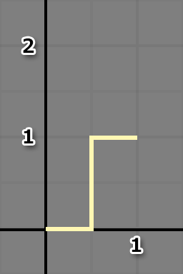
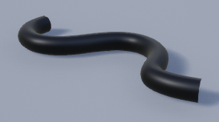
Root Growth FX
And when the value is truncated, it bounds 0.5 to 0 or 1.

Slide 22
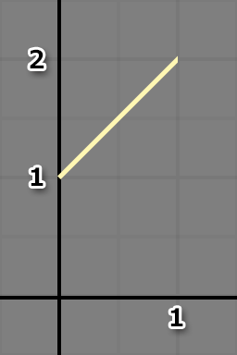
Root Growth FX
1
If the “BranchGrowth” is 1, the entire graph increase by 1.

Slide 23
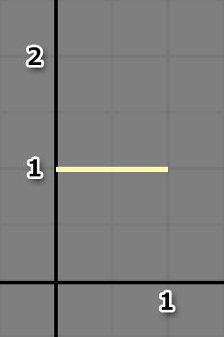
Root Growth FX
And when the value is truncated, it all goes to 1.

Slide 24
Root Growth FX
Check out the video again. (please press the play button below)

Slide 25
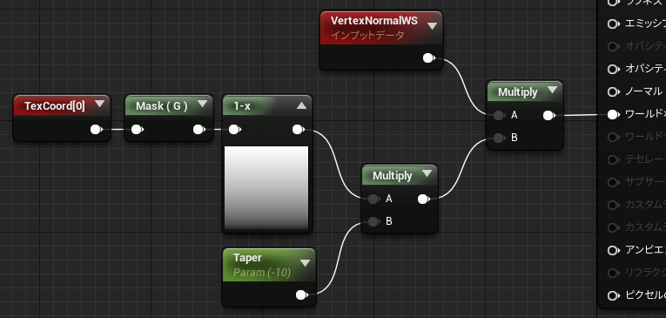
Root Growth FX
World Position Offset
Next, you can move the vertices and taper the model’s tip
by using the “World Position Offset”.

Slide 26
Root Growth FX
World Position Offset
It’s easy to multiply the “Vertex Normal WS” by the value.

Slide 27
Root Growth FX
World Position Offset
The gradient is inverted by using “One Minus”.
And it's specify slenderness of the model by the "Taper“ value.

Slide 28

Root Growth FX
World Position Offset
-10
0
In this case, the model is the thinnest when the “Taper” is -10.
And the black areas don’t change in slenderness.

Slide 29
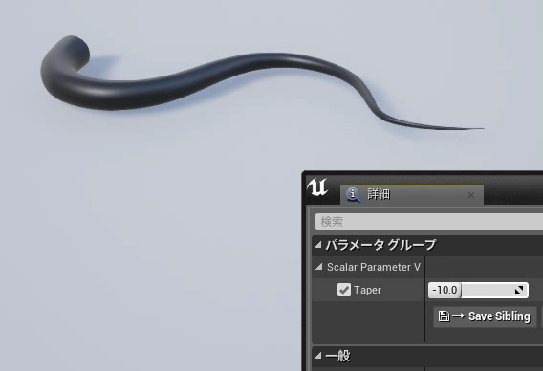
Root Growth FX
If you change the ”Taper”, the root will be thinner. (please press the play button below)

Slide 30
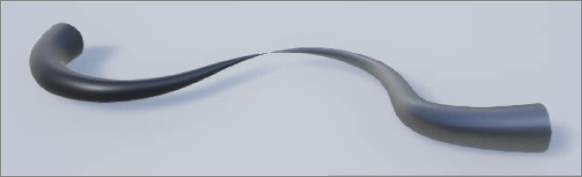
Root Growth FX
However, if you give it a value less than -10,
the model will be inverted,
and if you give it a value greater than 0,
it will be thicker than the original size...

Slide 31
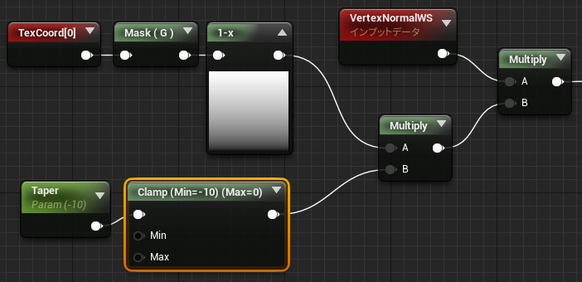
Root Growth FX
So you can use the “Clamp” node to limit the value.

Slide 32

Root Growth FX
Now that’s a good result. (please press the play button below)

Slide 33
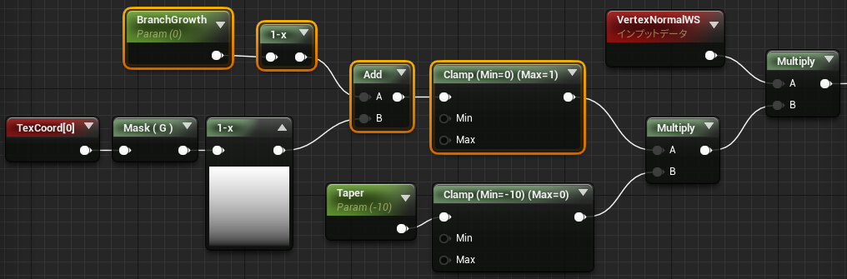
Root Growth FX
Then, combine first configuration of nodes “BranchGrowth”
with the one “Taper” you just created.

Slide 34
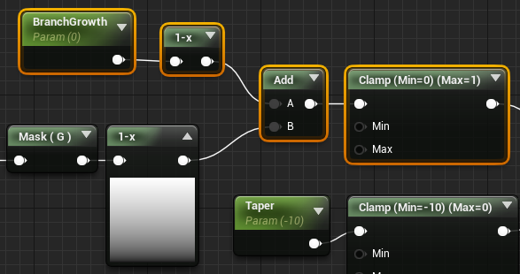
Root Growth FX
0
1
If the “BranchGrowth” is 0, the gradient will be completely
white and all the vertices will be tapered with the “Taper”.

Slide 35
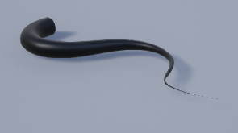
Root Growth FX
1
0
If the “BranchGrowth” is 1, the gradient will be unchanged.
So the model tapers from the root to the tip.

Slide 36
Root Growth FX
2
-1
If the “BranchGrowth” is 2, the gradient will be completely
black and all the vertices will be original thickness.

Slide 37
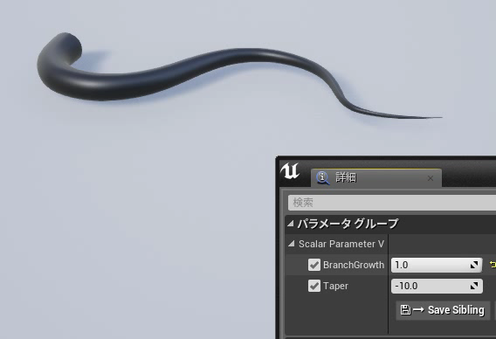
Root Growth FX
It’s good, except for one thing... (please press the play button below)

Slide 38
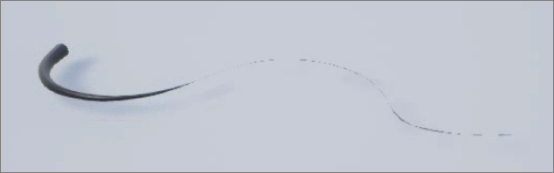
Root Growth FX
It’s mostly working well, but at its thinnest,
you can see what looks like garbage.

Slide 39
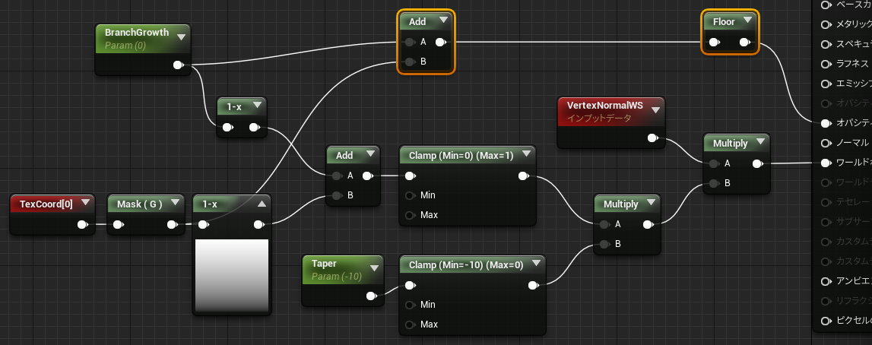
Root Growth FX
Opacity
World Position Offset
So let’s add the configuration I explained at the beginning,
which makes the root to the tip transparent.

Slide 40
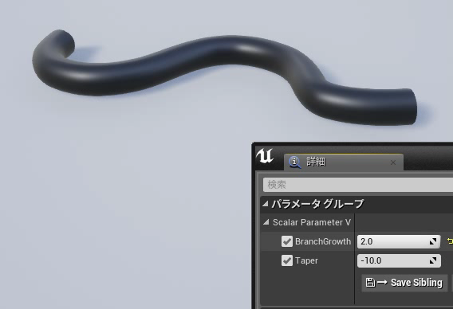
Root Growth FX
It’s so much better! That’s it for now. (please press the play button below)

Slide 41
Root Growth FX
You can try to add a material function “Smoothstep”.
By doing so, you can change the gradient.

Slide 42
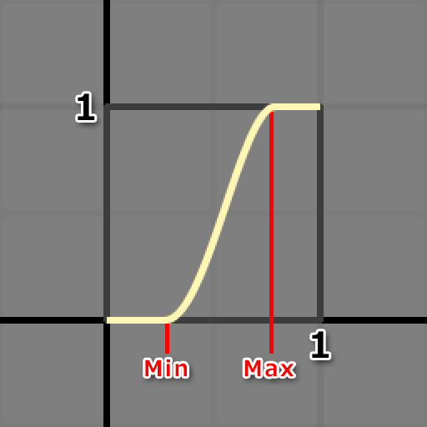
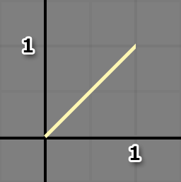
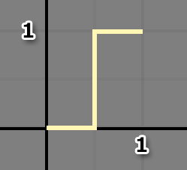
Root Growth FX
“SmoothStep” is a function of HLSL that interpolates
with the S-curve between the Min value and the Max value.

Slide 43
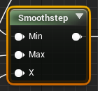
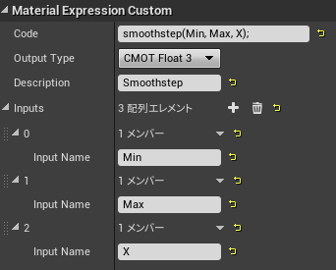
Root Growth FX
Configure the custom node as shown in the figure.

Slide 44
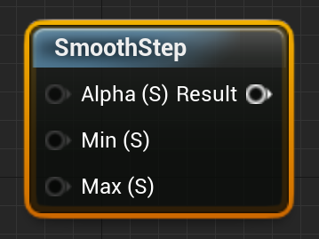
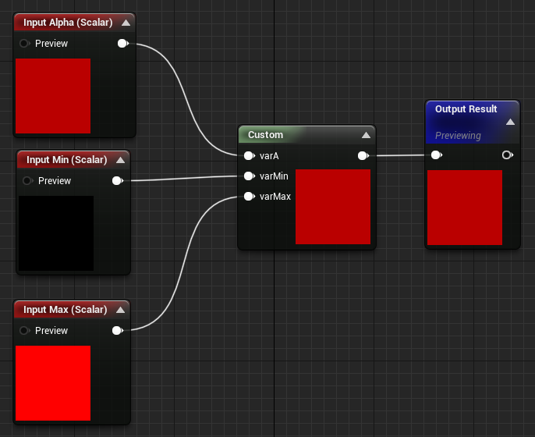
Root Growth FX
On UE4, there is a material function of SmoothStep.

Slide 45
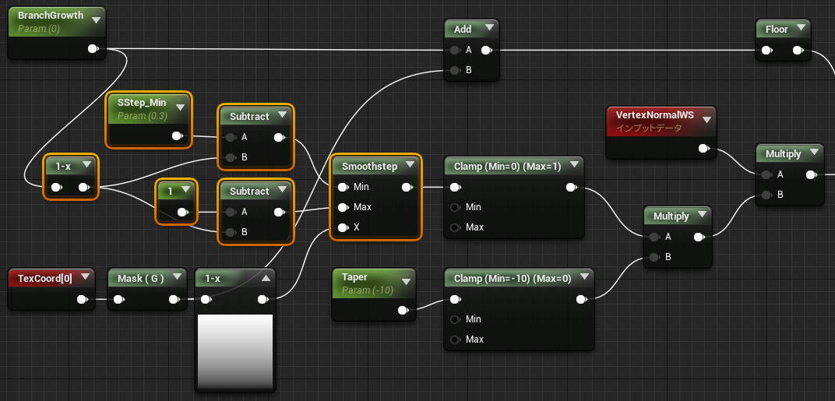
Root Growth FX
For example, the configuration can be added
as shown in the figure.

Slide 46
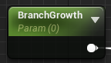
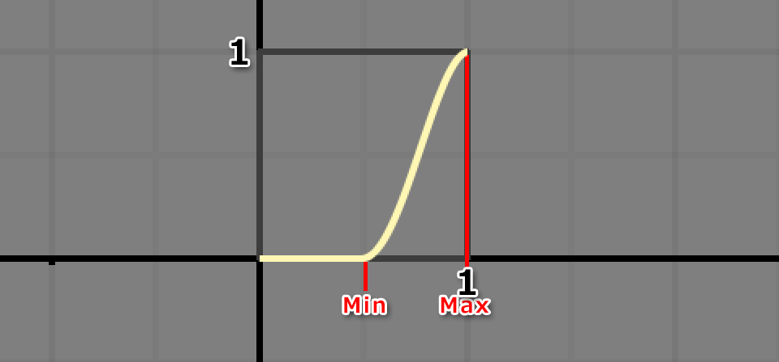
Root Growth FX
1
If the “BranchGrowth” is 1,
the graph falls within the range of 0 to 1.

Slide 47
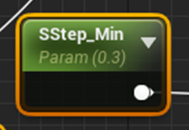
Root Growth FX
1
And if you change the “SStep_Min” value,
the position where you start to get thinner will change.

Slide 48
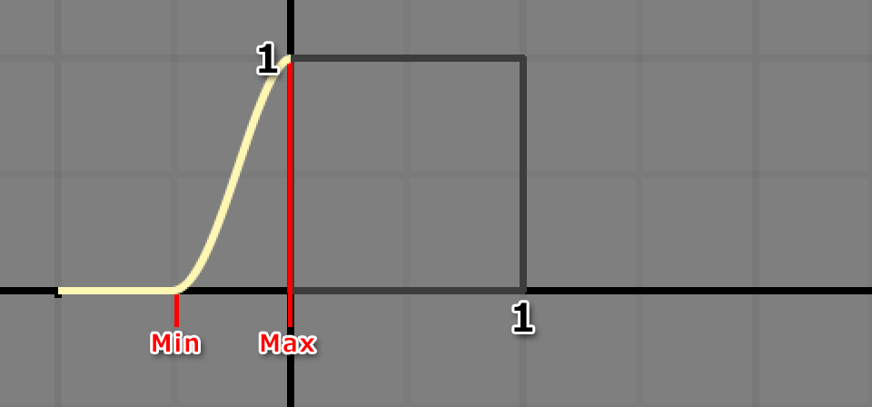
Root Growth FX
0
If the “BranchGrowth” is 0, then Min and Max are set to
less than 0 to make the entire model completely thin.

Slide 49
Root Growth FX
0
-1
This is very easy to do, you just nees to set
the Min value and the Max value to -1.

Slide 50
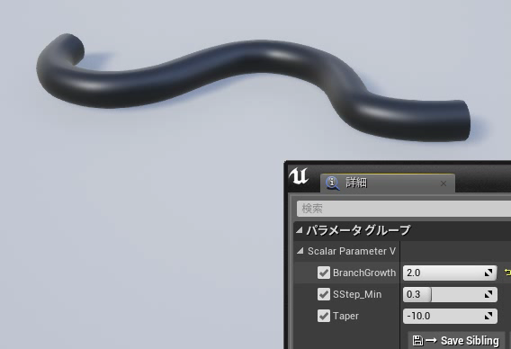
Root Growth FX
So you can now change the thickness of the root at will! (please press the play button below)

Slide 51

Root Growth FX
God of War ©2018 Sony Interactive Entertainment LLC
There's a scene in “God of War” where the tree roots move,
and I thought it was using Vertex Animation Texture to represent it.
However, this method can be done with a simple shader without
consuming a lot of memory for the transformation.
The scales fell from my eyes.

Slide 52
Root Growth FX
Moving vertices with a “World Position Offset”
seems to bequite useful.
Thanks to Gil Damoiseaux for the great insight!
(And “DeepL Translate” has given me great help.)

Slide 53
Thank you for watching! :)

